Slide 1
Empowered Learning
Migrated iPad Set Up
Student at home

Slide 2
Migrating an iPad or Setting up a new one?
The first part of these instructions is slightly different depending on whether you are migrating an iPad or setting up a brand new one.
IF you are migrating an iPad you need to first follow Steps A to C, then Step 1 onwards.
OR
IF you are setting up a brand-new iPad start with Step 1, which is on Slide 7.

Slide 3
* Did you ‘back up’ your iPad? *
*You should have already saved your work to OneDrive – if not, please do this before you begin.
If you are not sure, check with your teacher when you are back in school.*

Slide 4
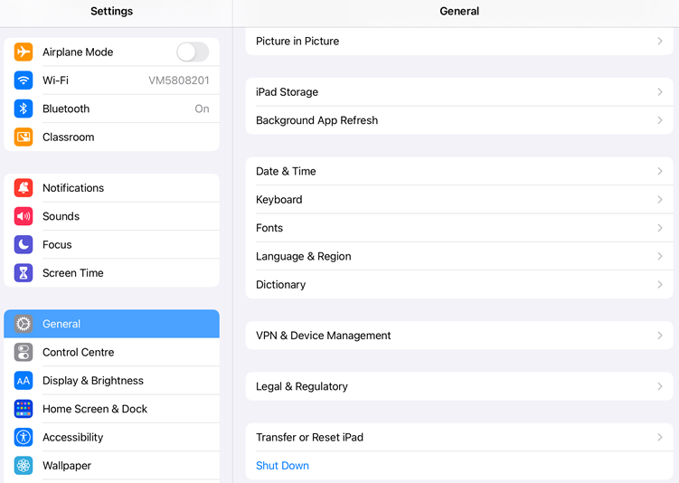
A. Erase Your iPad (part 1)
Open Settings
Then General
Tap Transfer or
Reset iPad

Slide 5
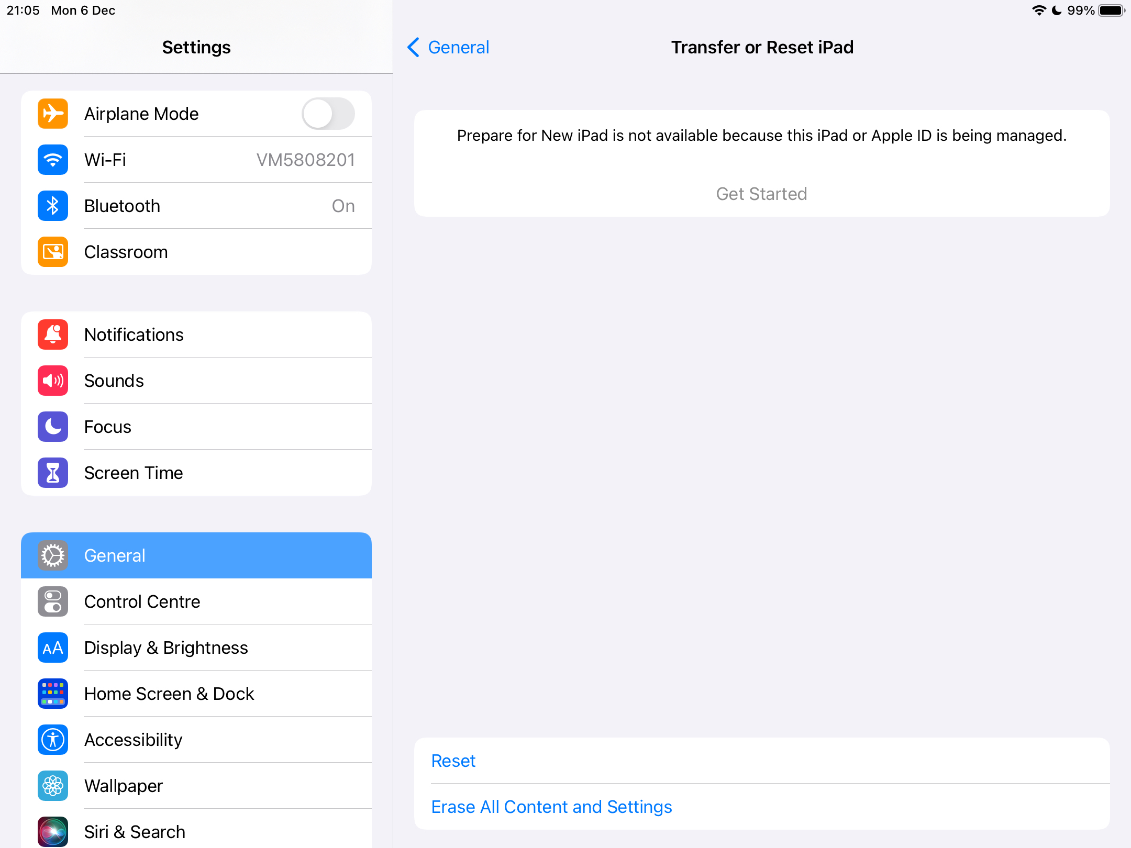
B. Erase Your iPad (part 2)
Tap Erase all content and settings

Slide 6
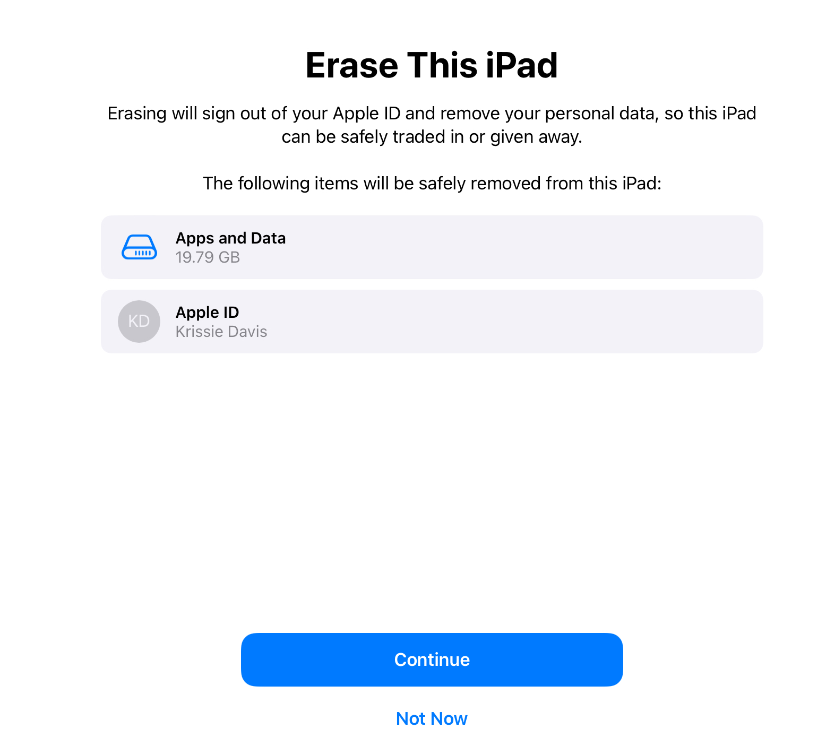
C. Erase Your iPad (part 3)
Tap Continue

Slide 7

1. Power on your iPad
“Hello Screen”
Press the Home Button at bottom of the screen (on black screen frame)

Slide 8
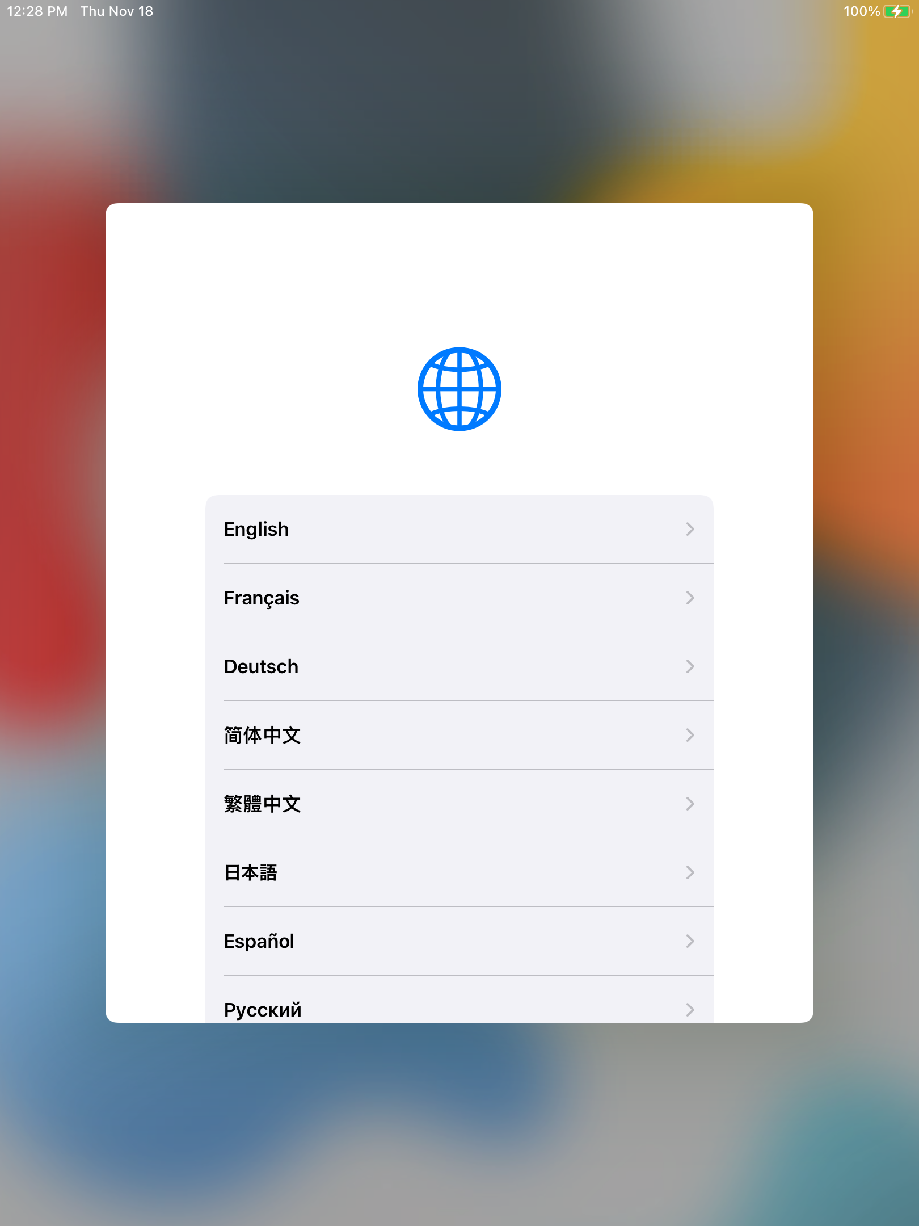
2. Select Language Screen
Select the English language option

Slide 9
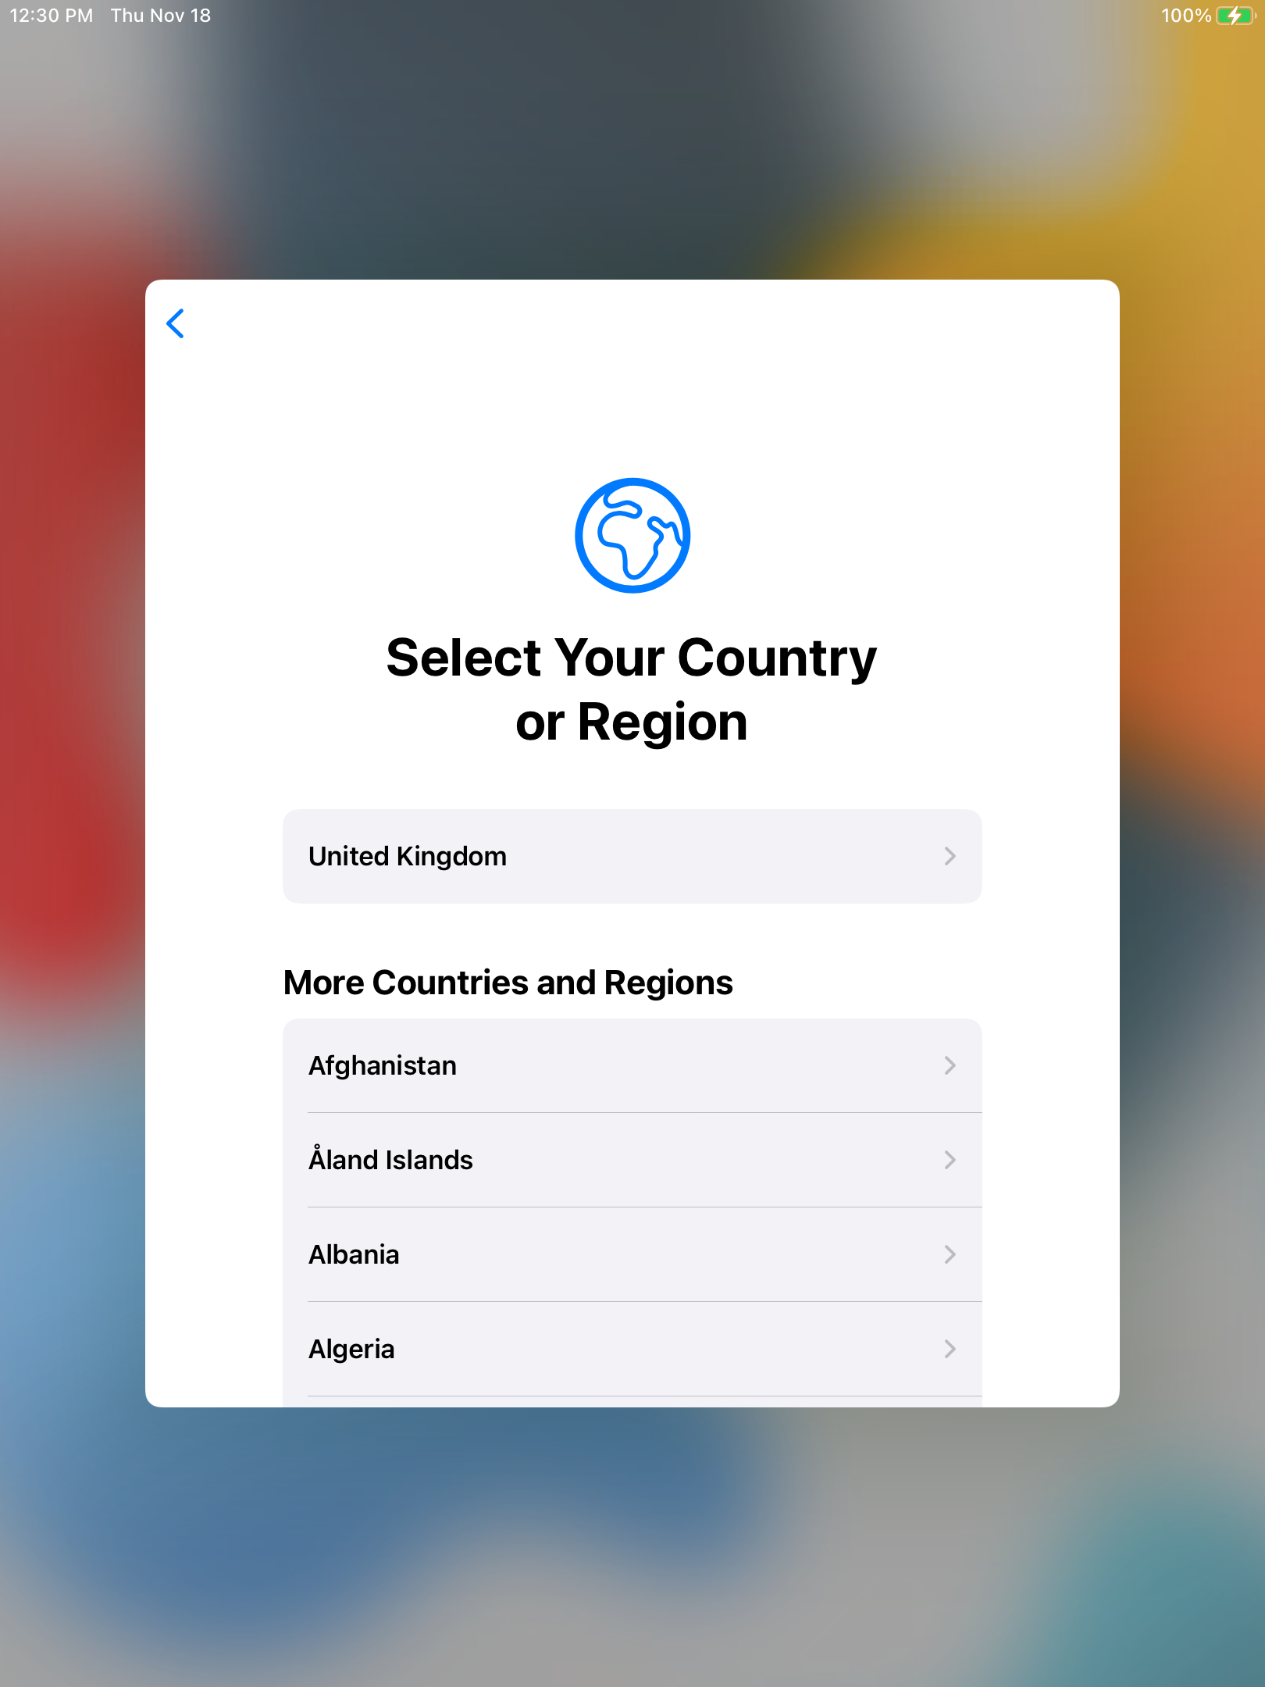
3. Select Country Screen
Select the United Kingdom Country option

Slide 10
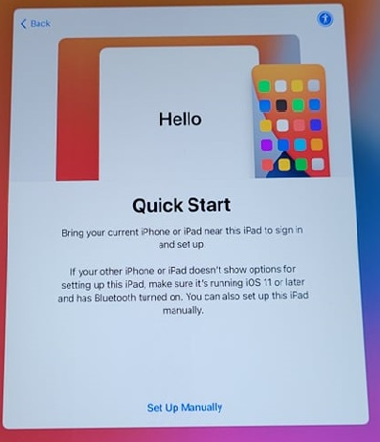
4. Quick Start
Tap Set Up Manually

Slide 11
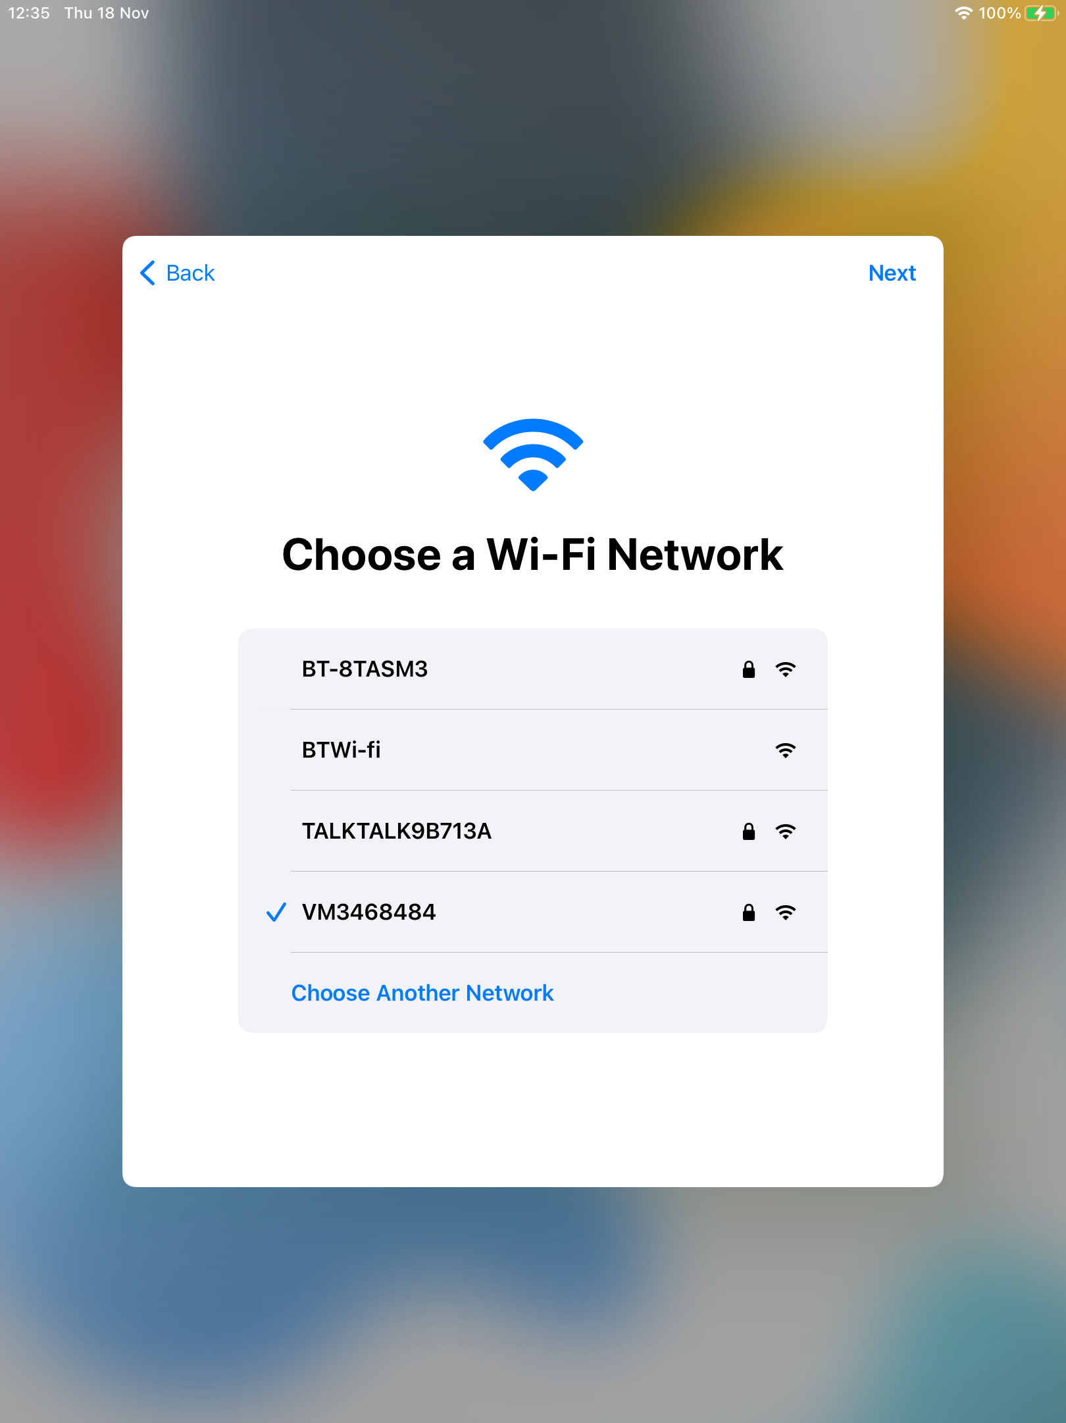
5. Choose Wi-Fi Network
Choose your home Wi-Fi from the available list
Enter your home Wi-Fi Password
Click Next to continue to the Remote Management screen

Slide 12
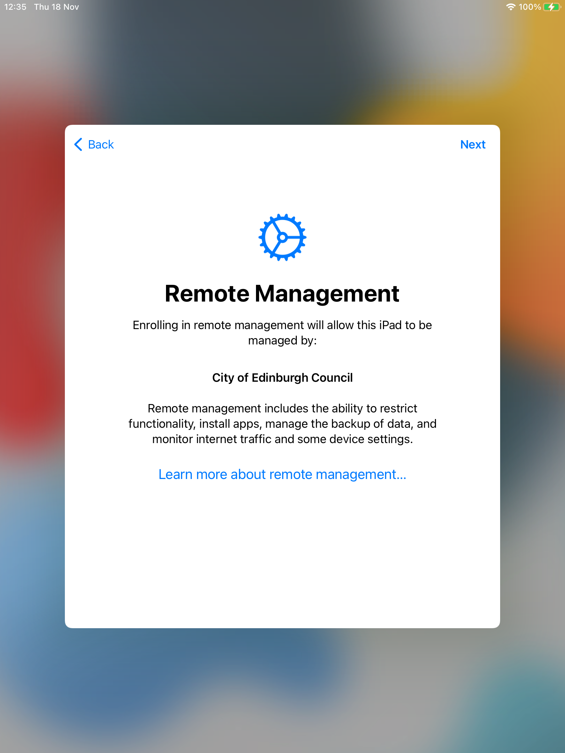
6. Remote Management Screen
Tap Next

Slide 13
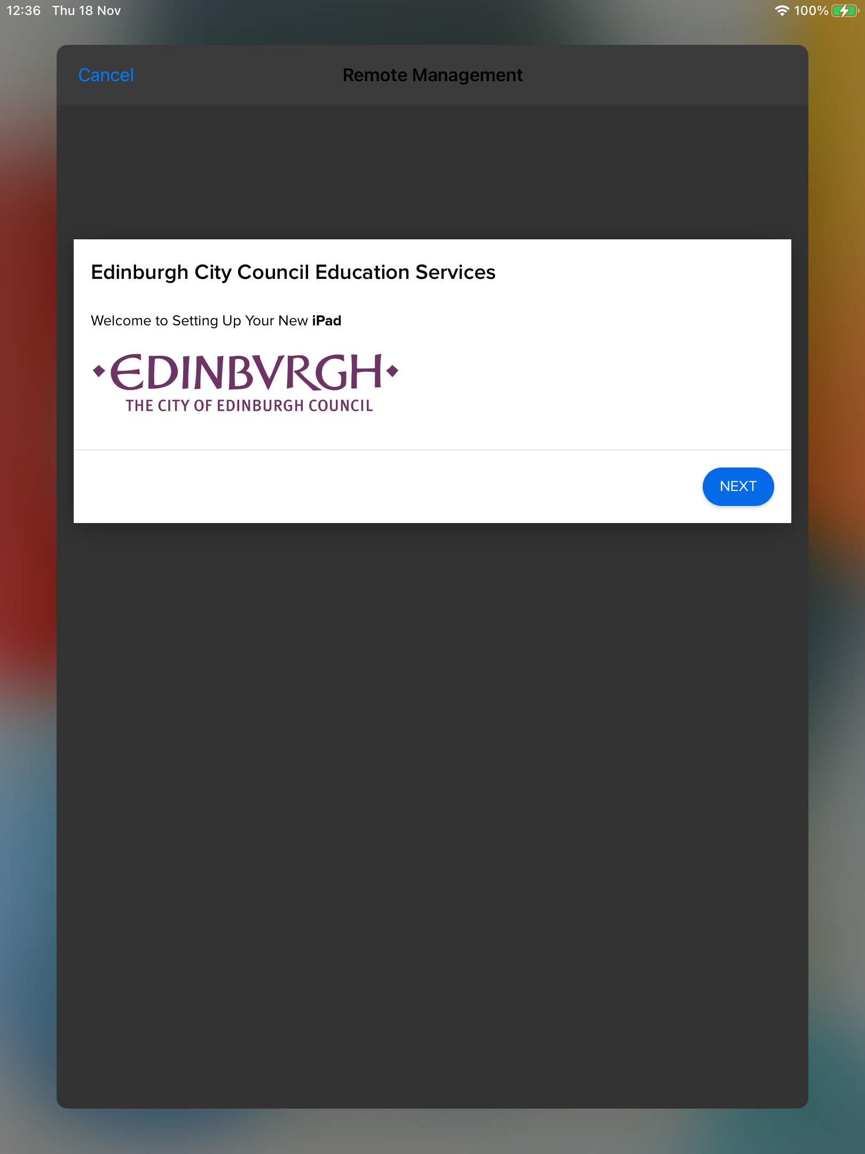
7. Edinburgh Logo Screen
Tap Next (only tap once)
*Be patient, it may take some time for the next screen to appear
The next screen will be the Remote Management sign in screen

Slide 14
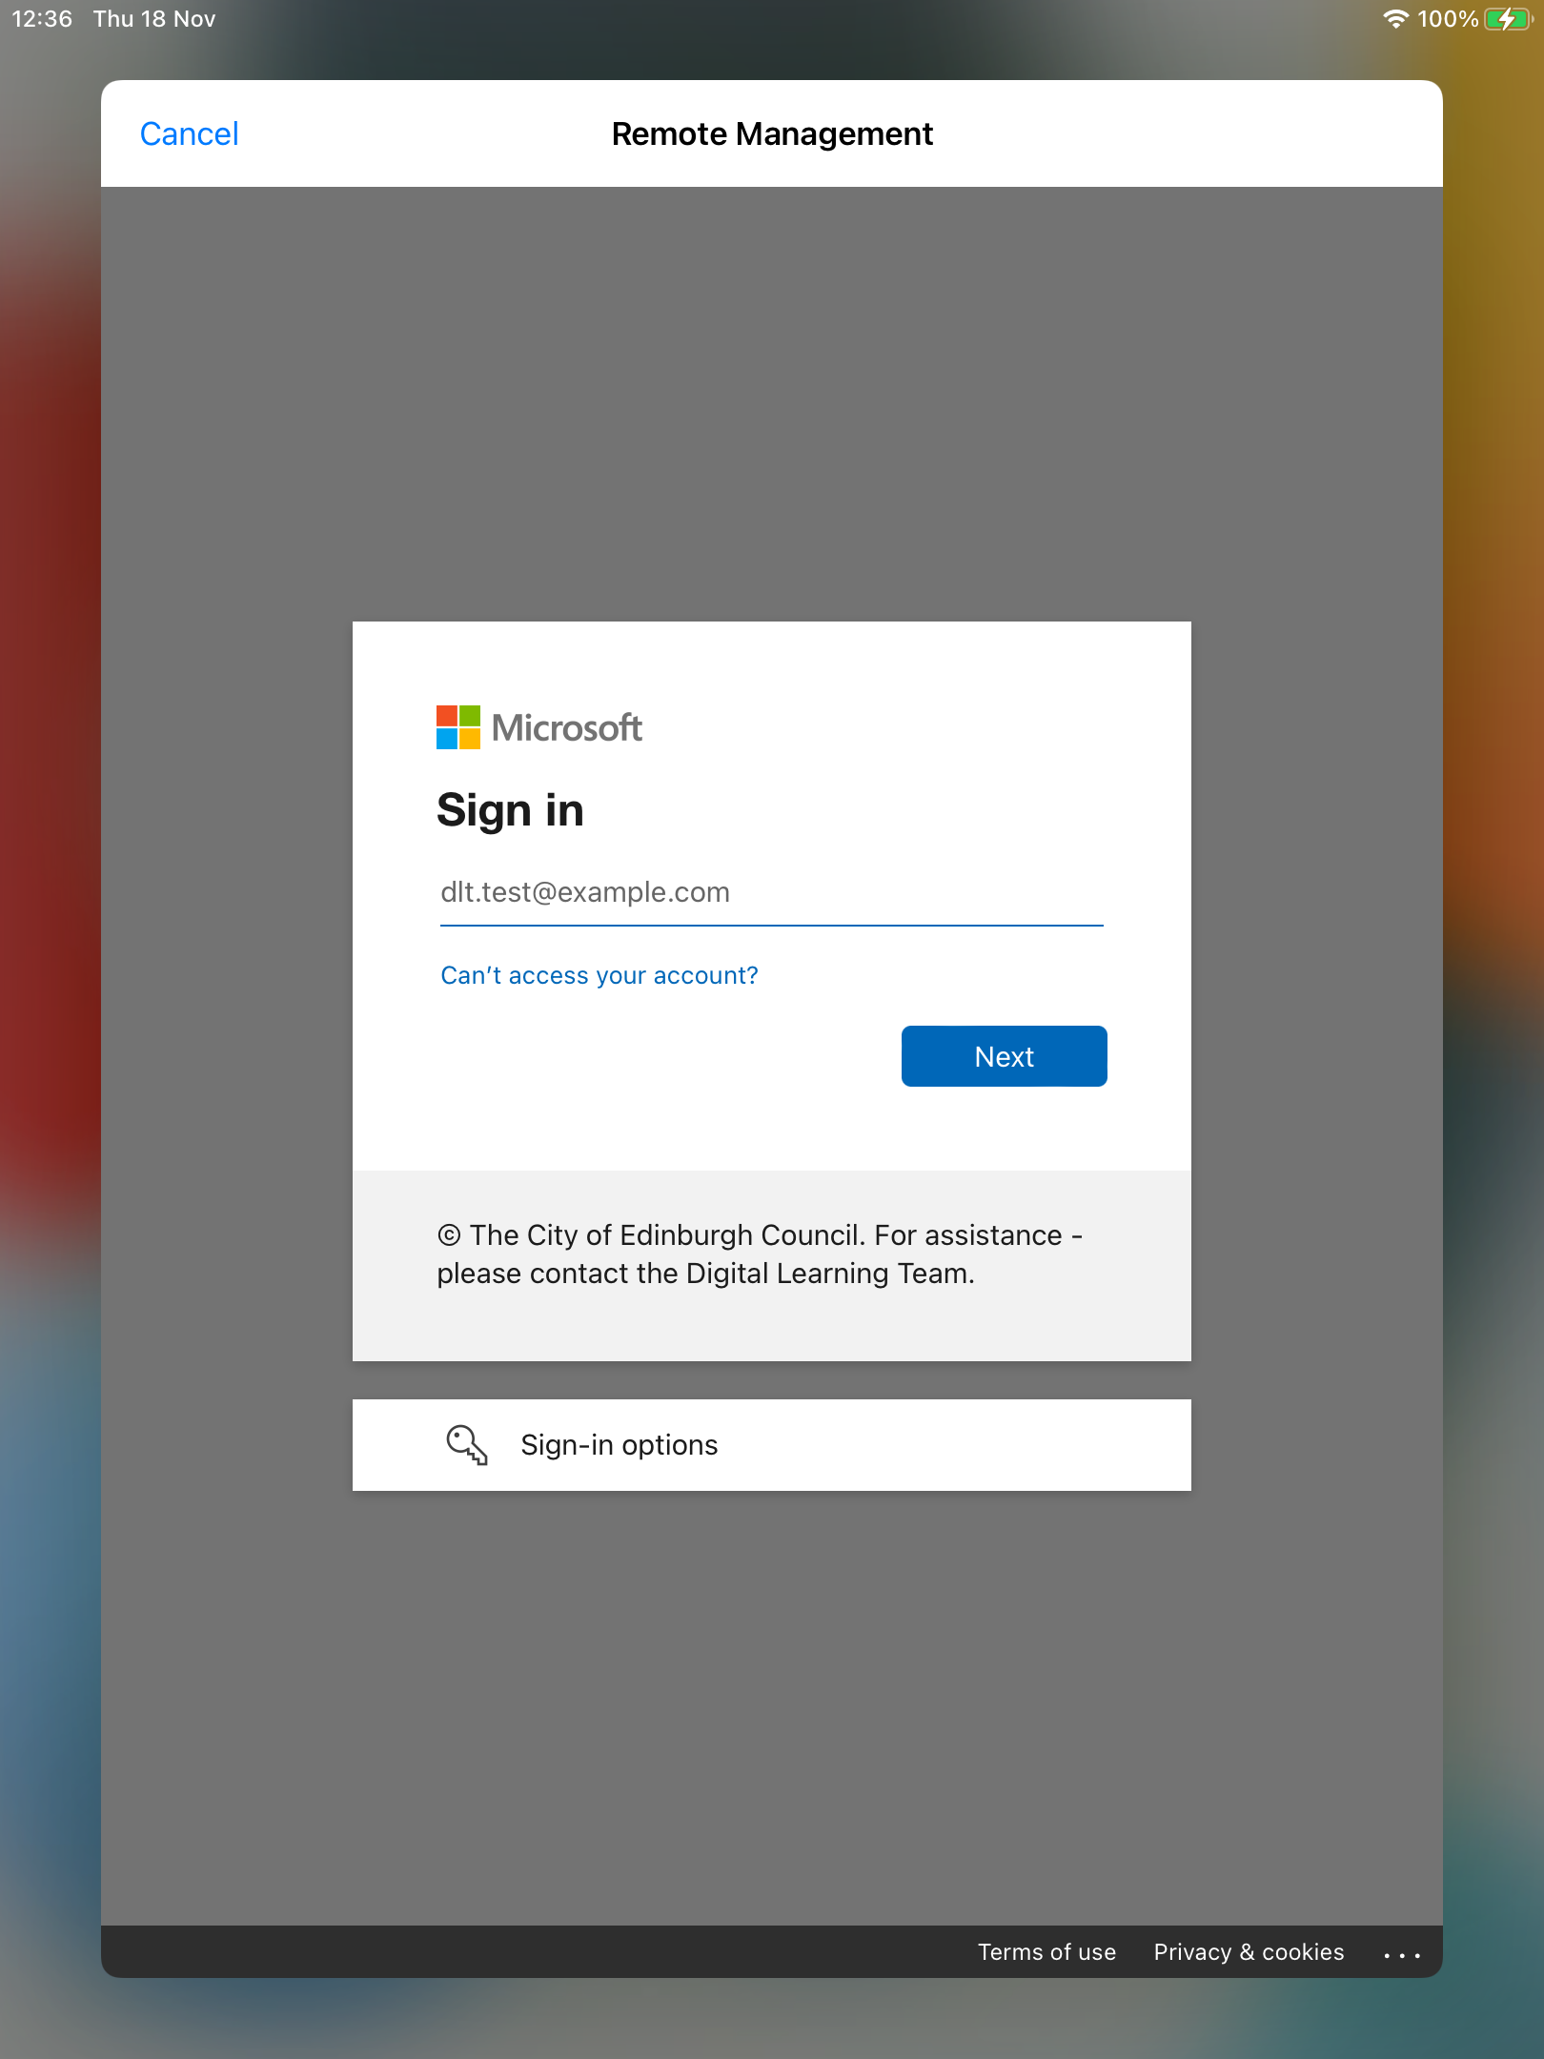
8. Microsoft Sign In Screen
Enter your Office 365 login Username.
Note: Your Office 365 login is your SCN followed by @ea.edin.sch.uk
b)Tap Next

Slide 15
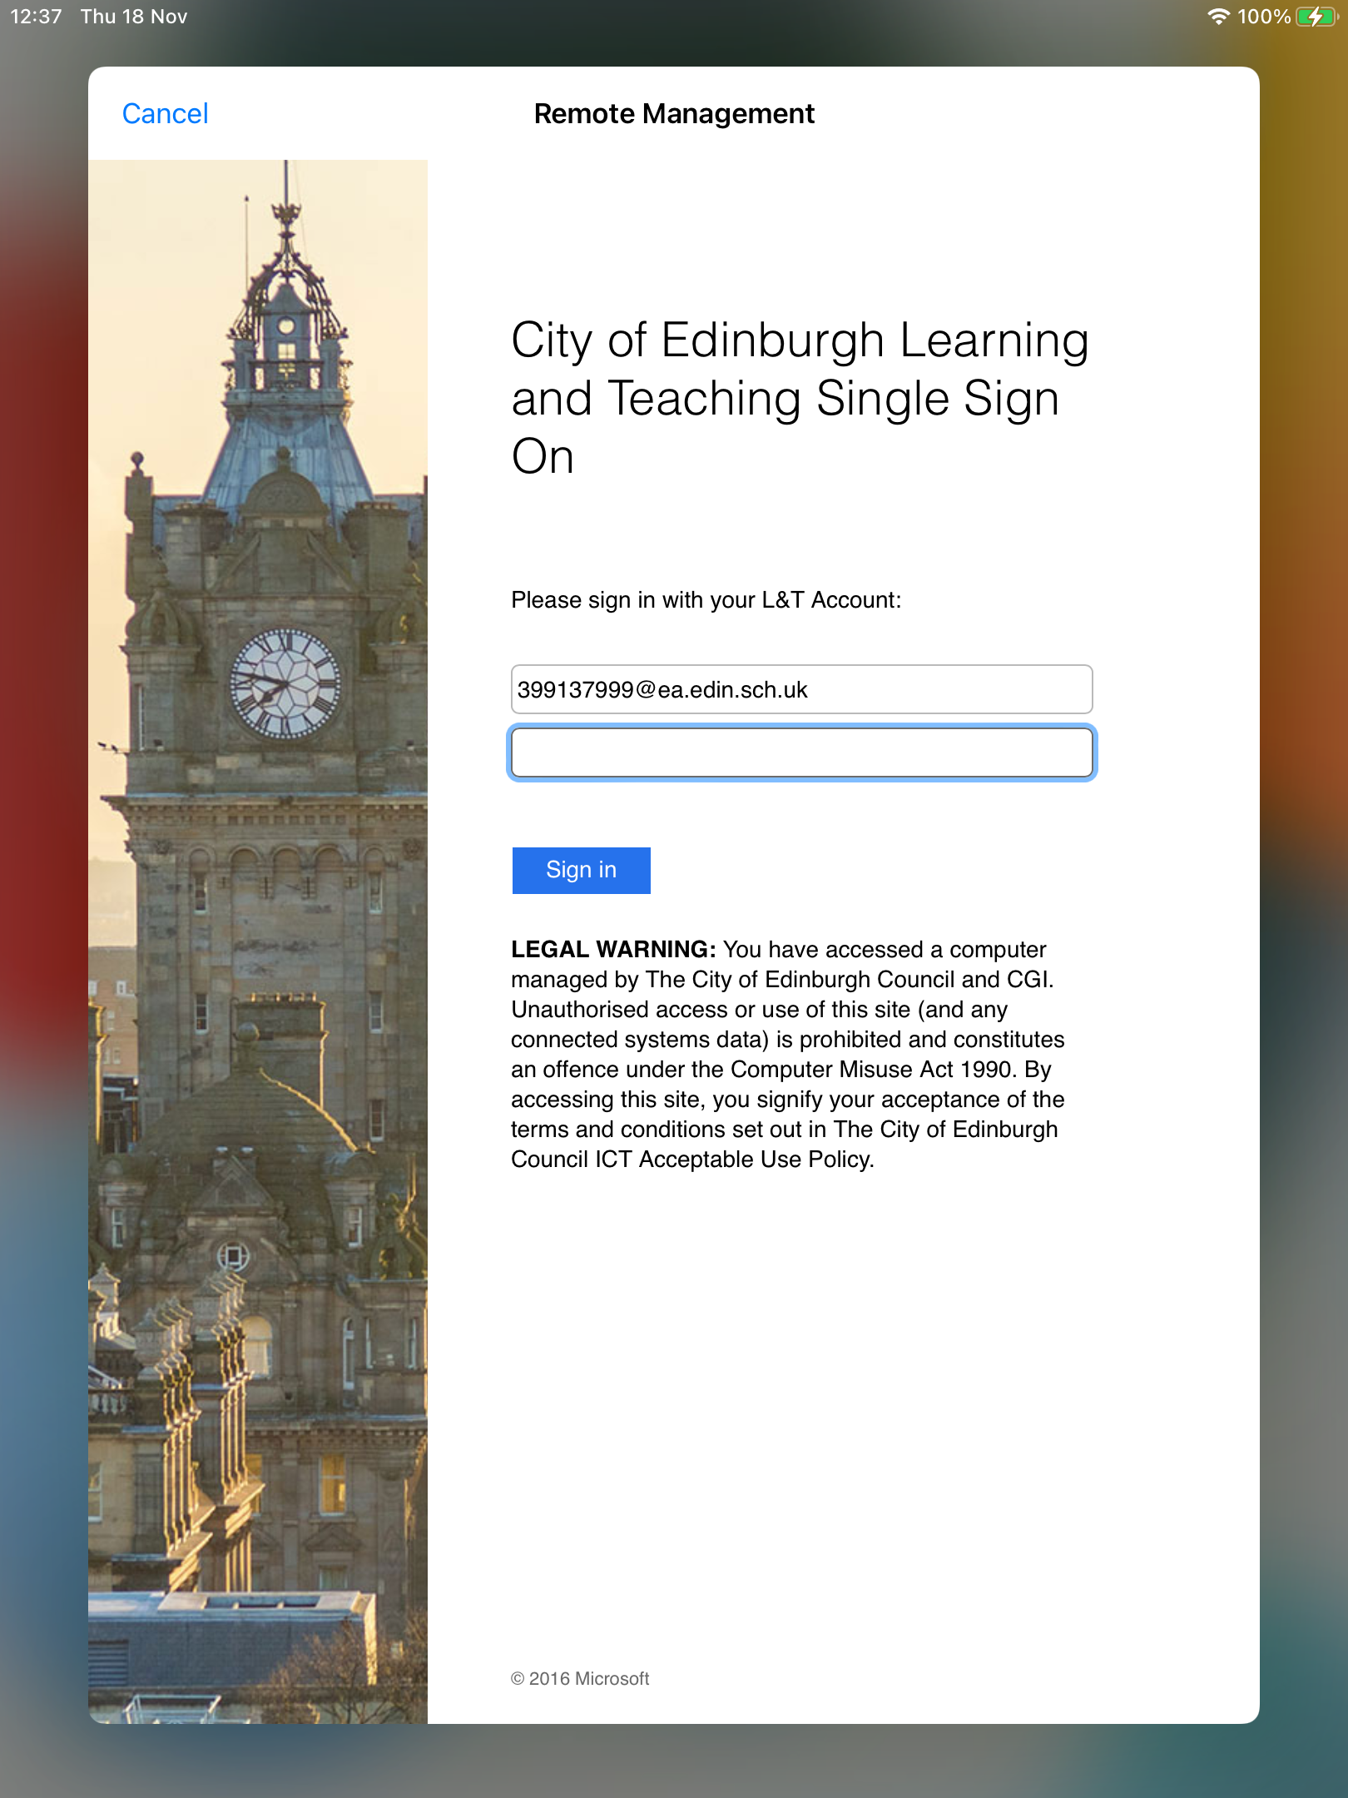
9. Password
a) Enter your normal network Password
e.g., EmpoweredLearning2022$
Note: Your normal network password is the same as the one you use on the PCs on the school network and on Teams.
b) Tap Sign in

Slide 16
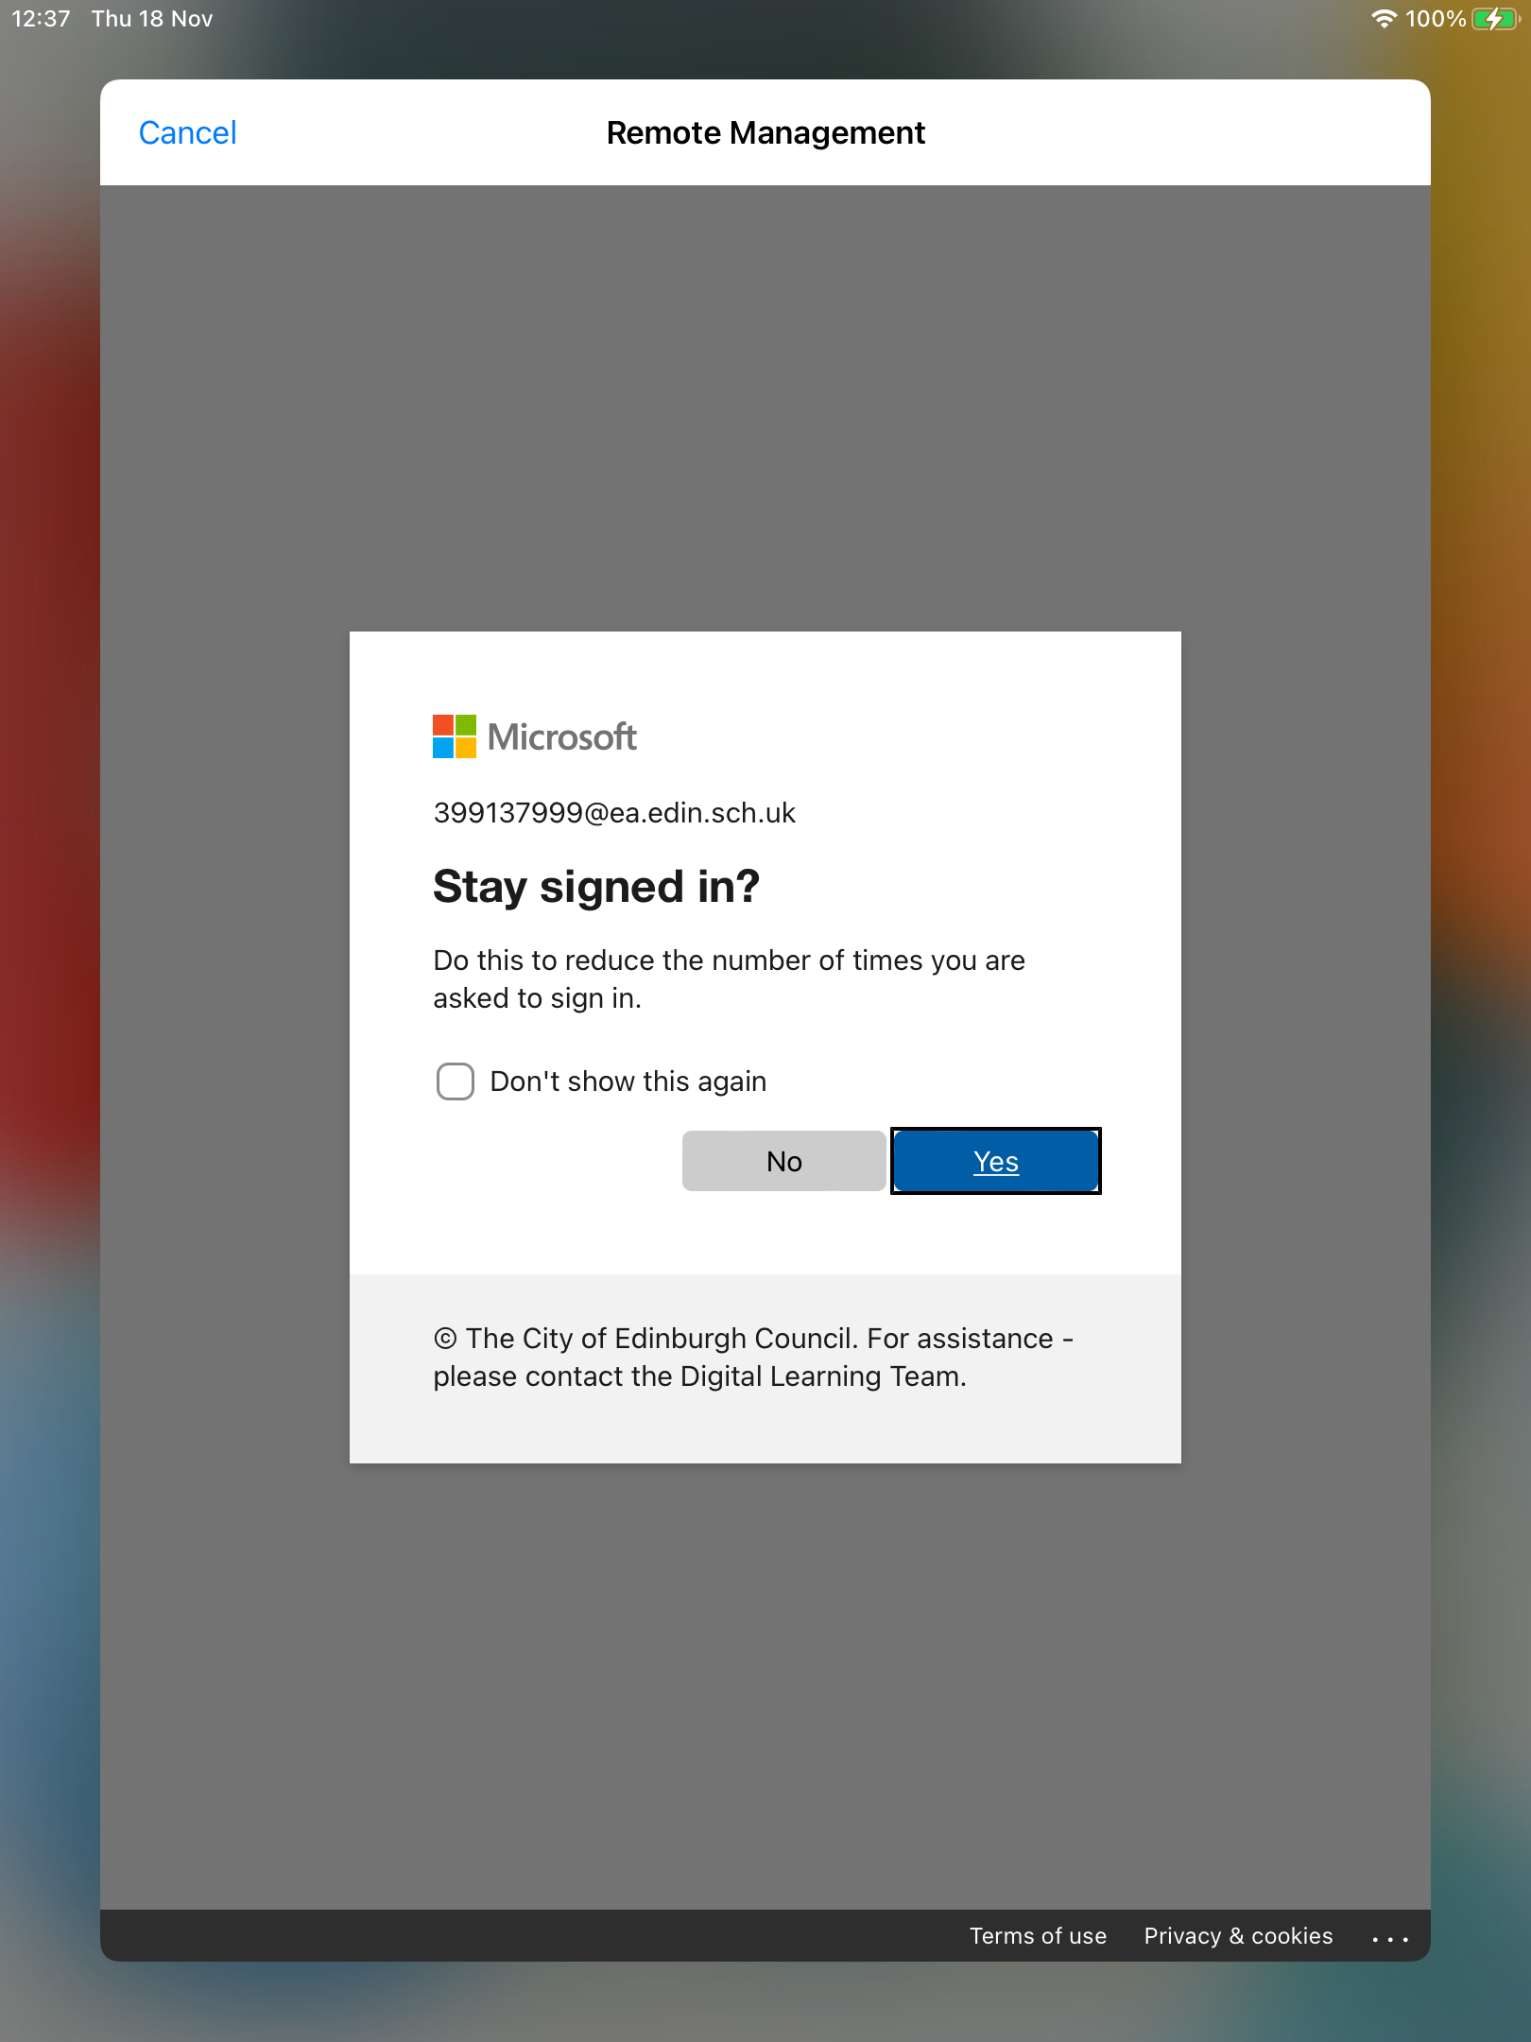
10. Stay signed in?
Tap the Yes button to stay signed in.

Slide 17
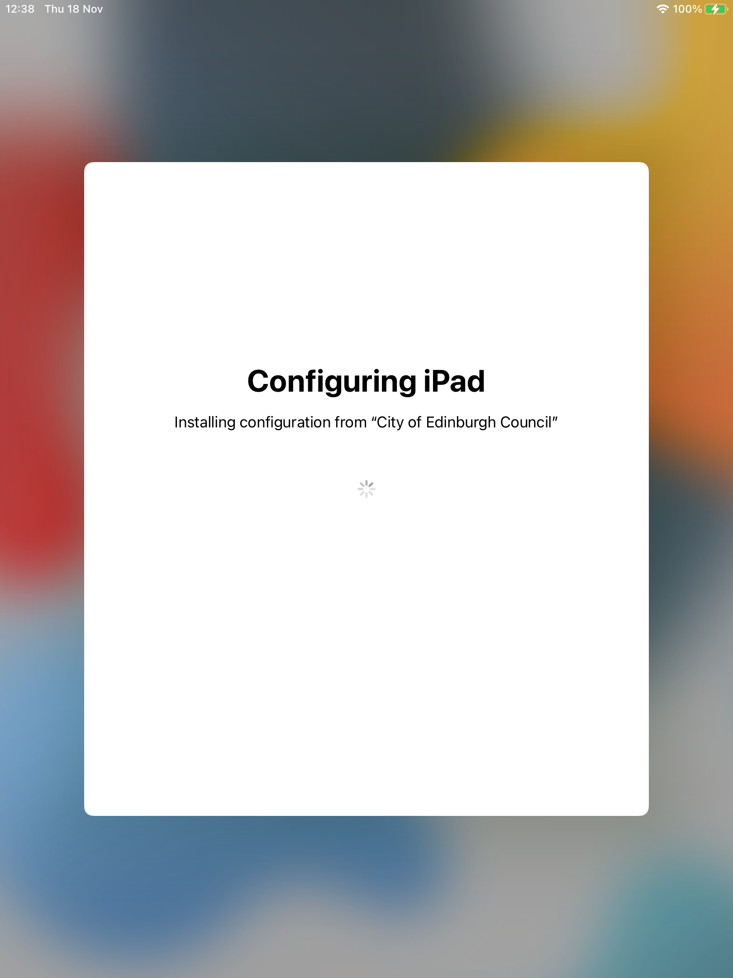
11. Configuring iPad
This screen may take a few minutes to move on…

Slide 18
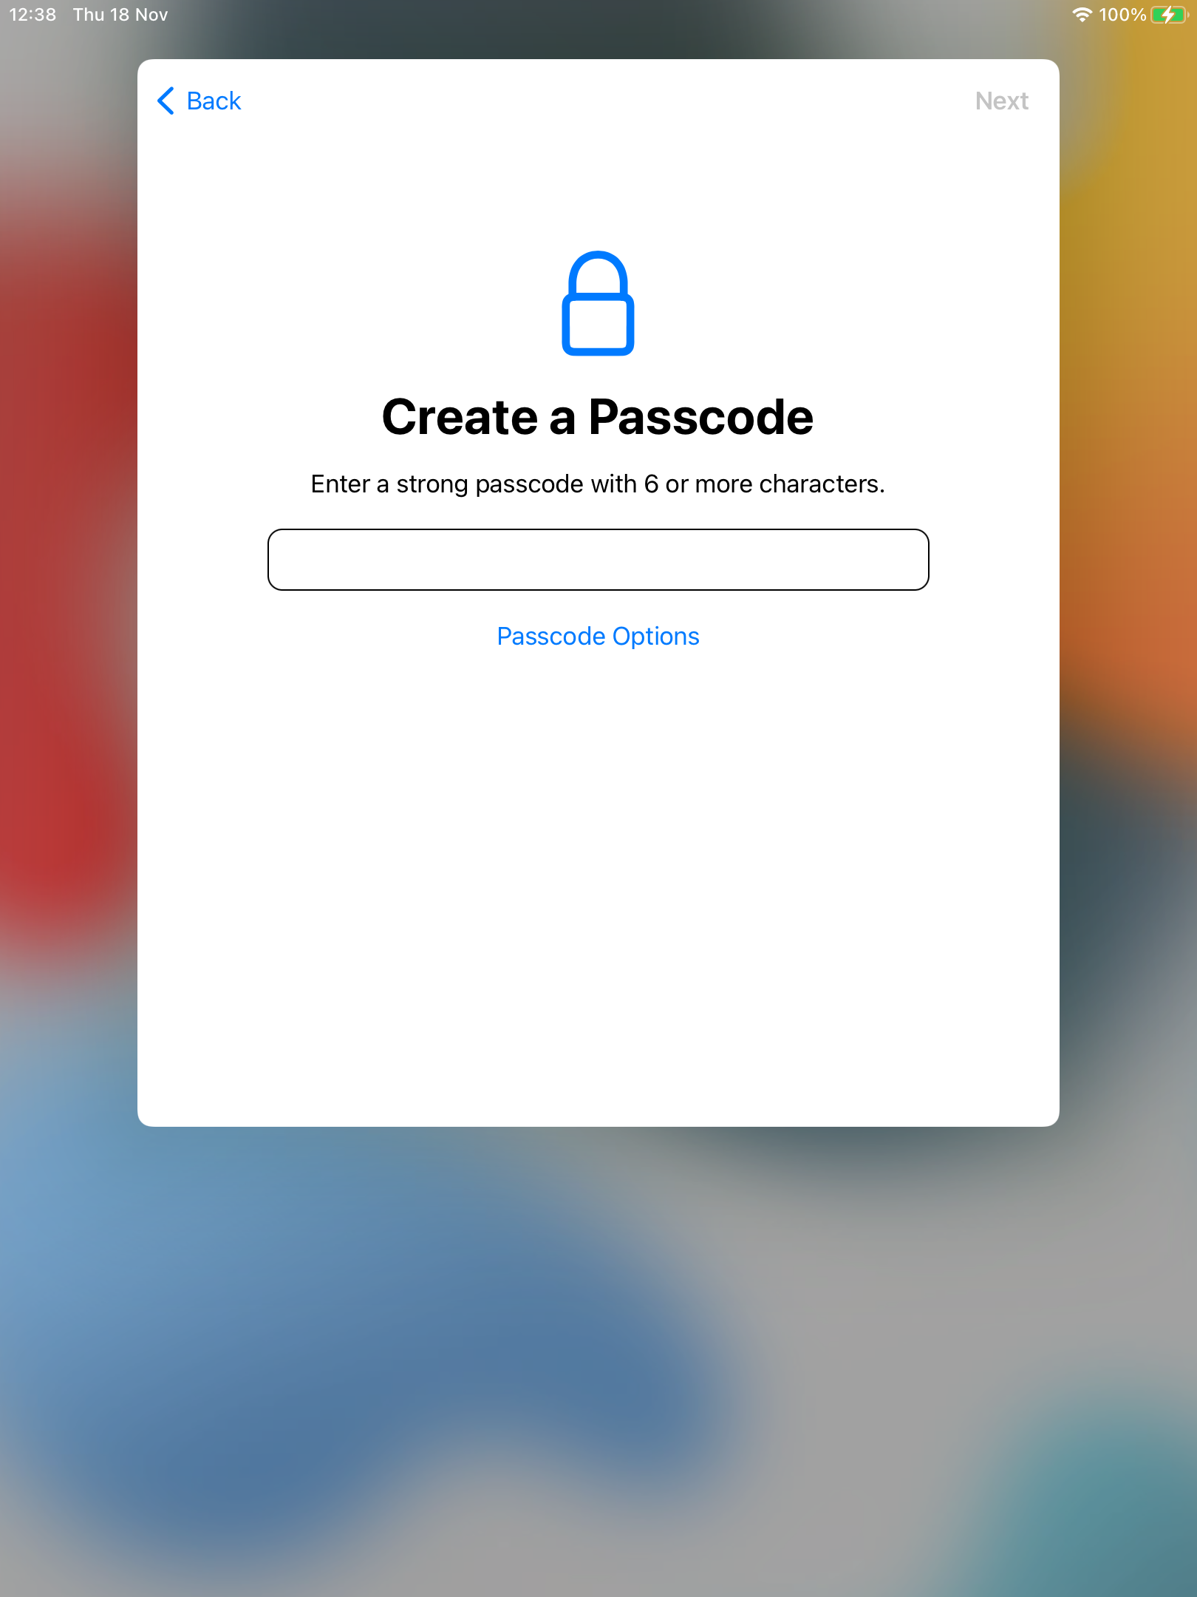
12. Create Passcode
Enter your personal Passcode
You will need this passcode to unlock your iPad when you turn it on or ‘wake it’.
We recommend you set this as the same as your network password
b)Tap Next

Slide 19

13. Re-enter Passcode
Re-enter your personal Passcode
Tap Next

Slide 20
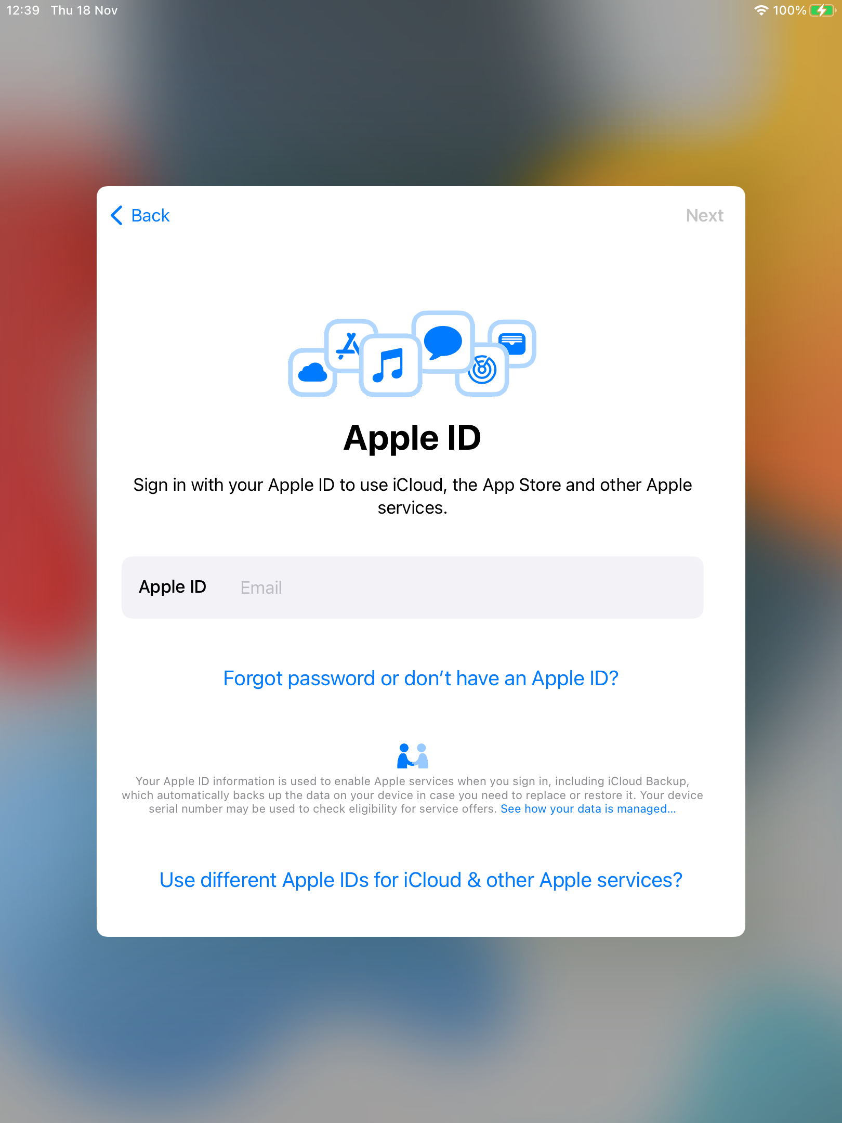
14. Apple ID
Enter the Managed Apple ID that you were given by your teacher e.g.
Note: Your Managed Apple ID is your SCN followed by
@appleid.ea.edin.sch.uk
Tap Next

Slide 21
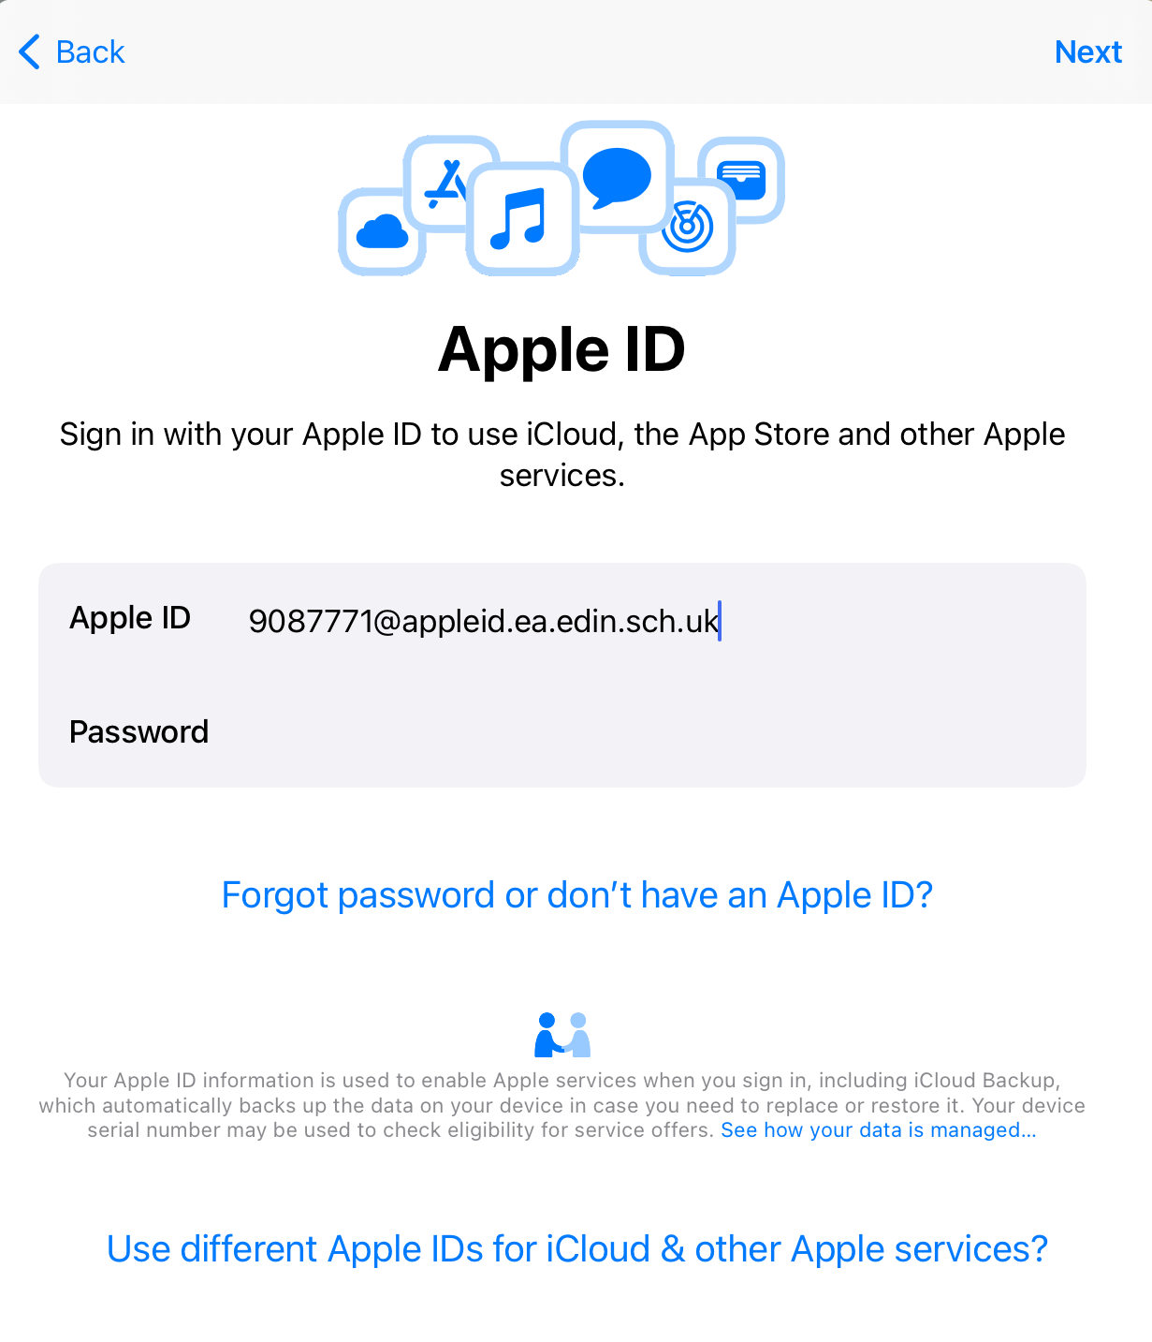
15. Enter the Password for your Apple ID
  Enter the temporary Managed Apple ID Password that you were given by your teacher
  Tap Next

Slide 22
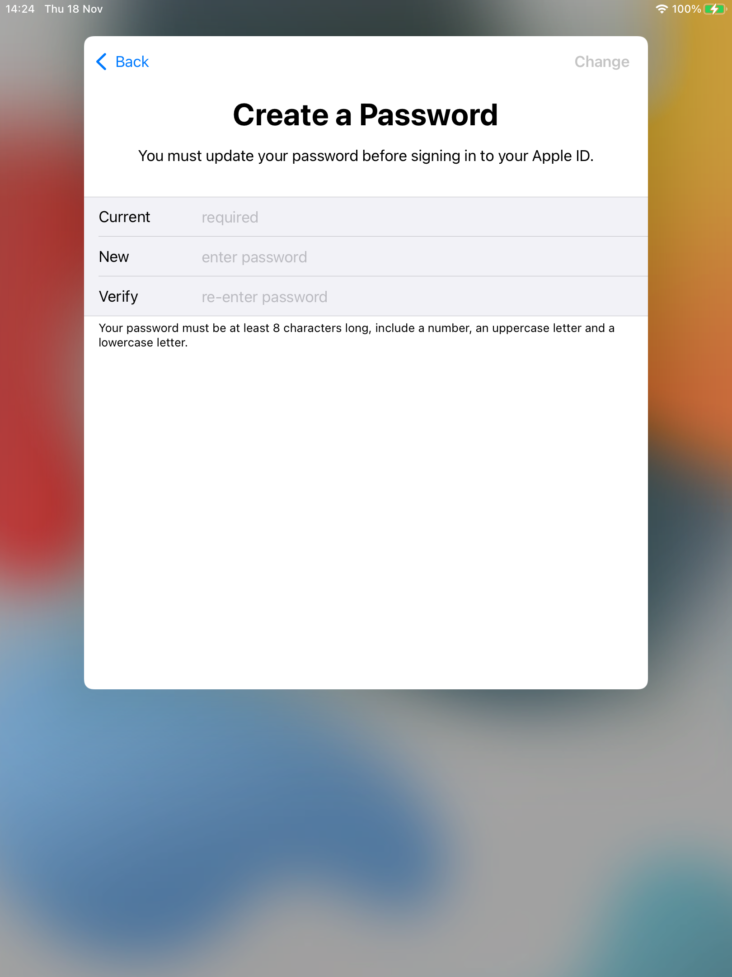
16. Create Apple Password
Re-enter the temporary Apple ID Password, that you were given by your teacher (current password)
Enter a new Password (make it the same as your network password)
Re-enter the network Password to verify
Tap Change

Slide 23
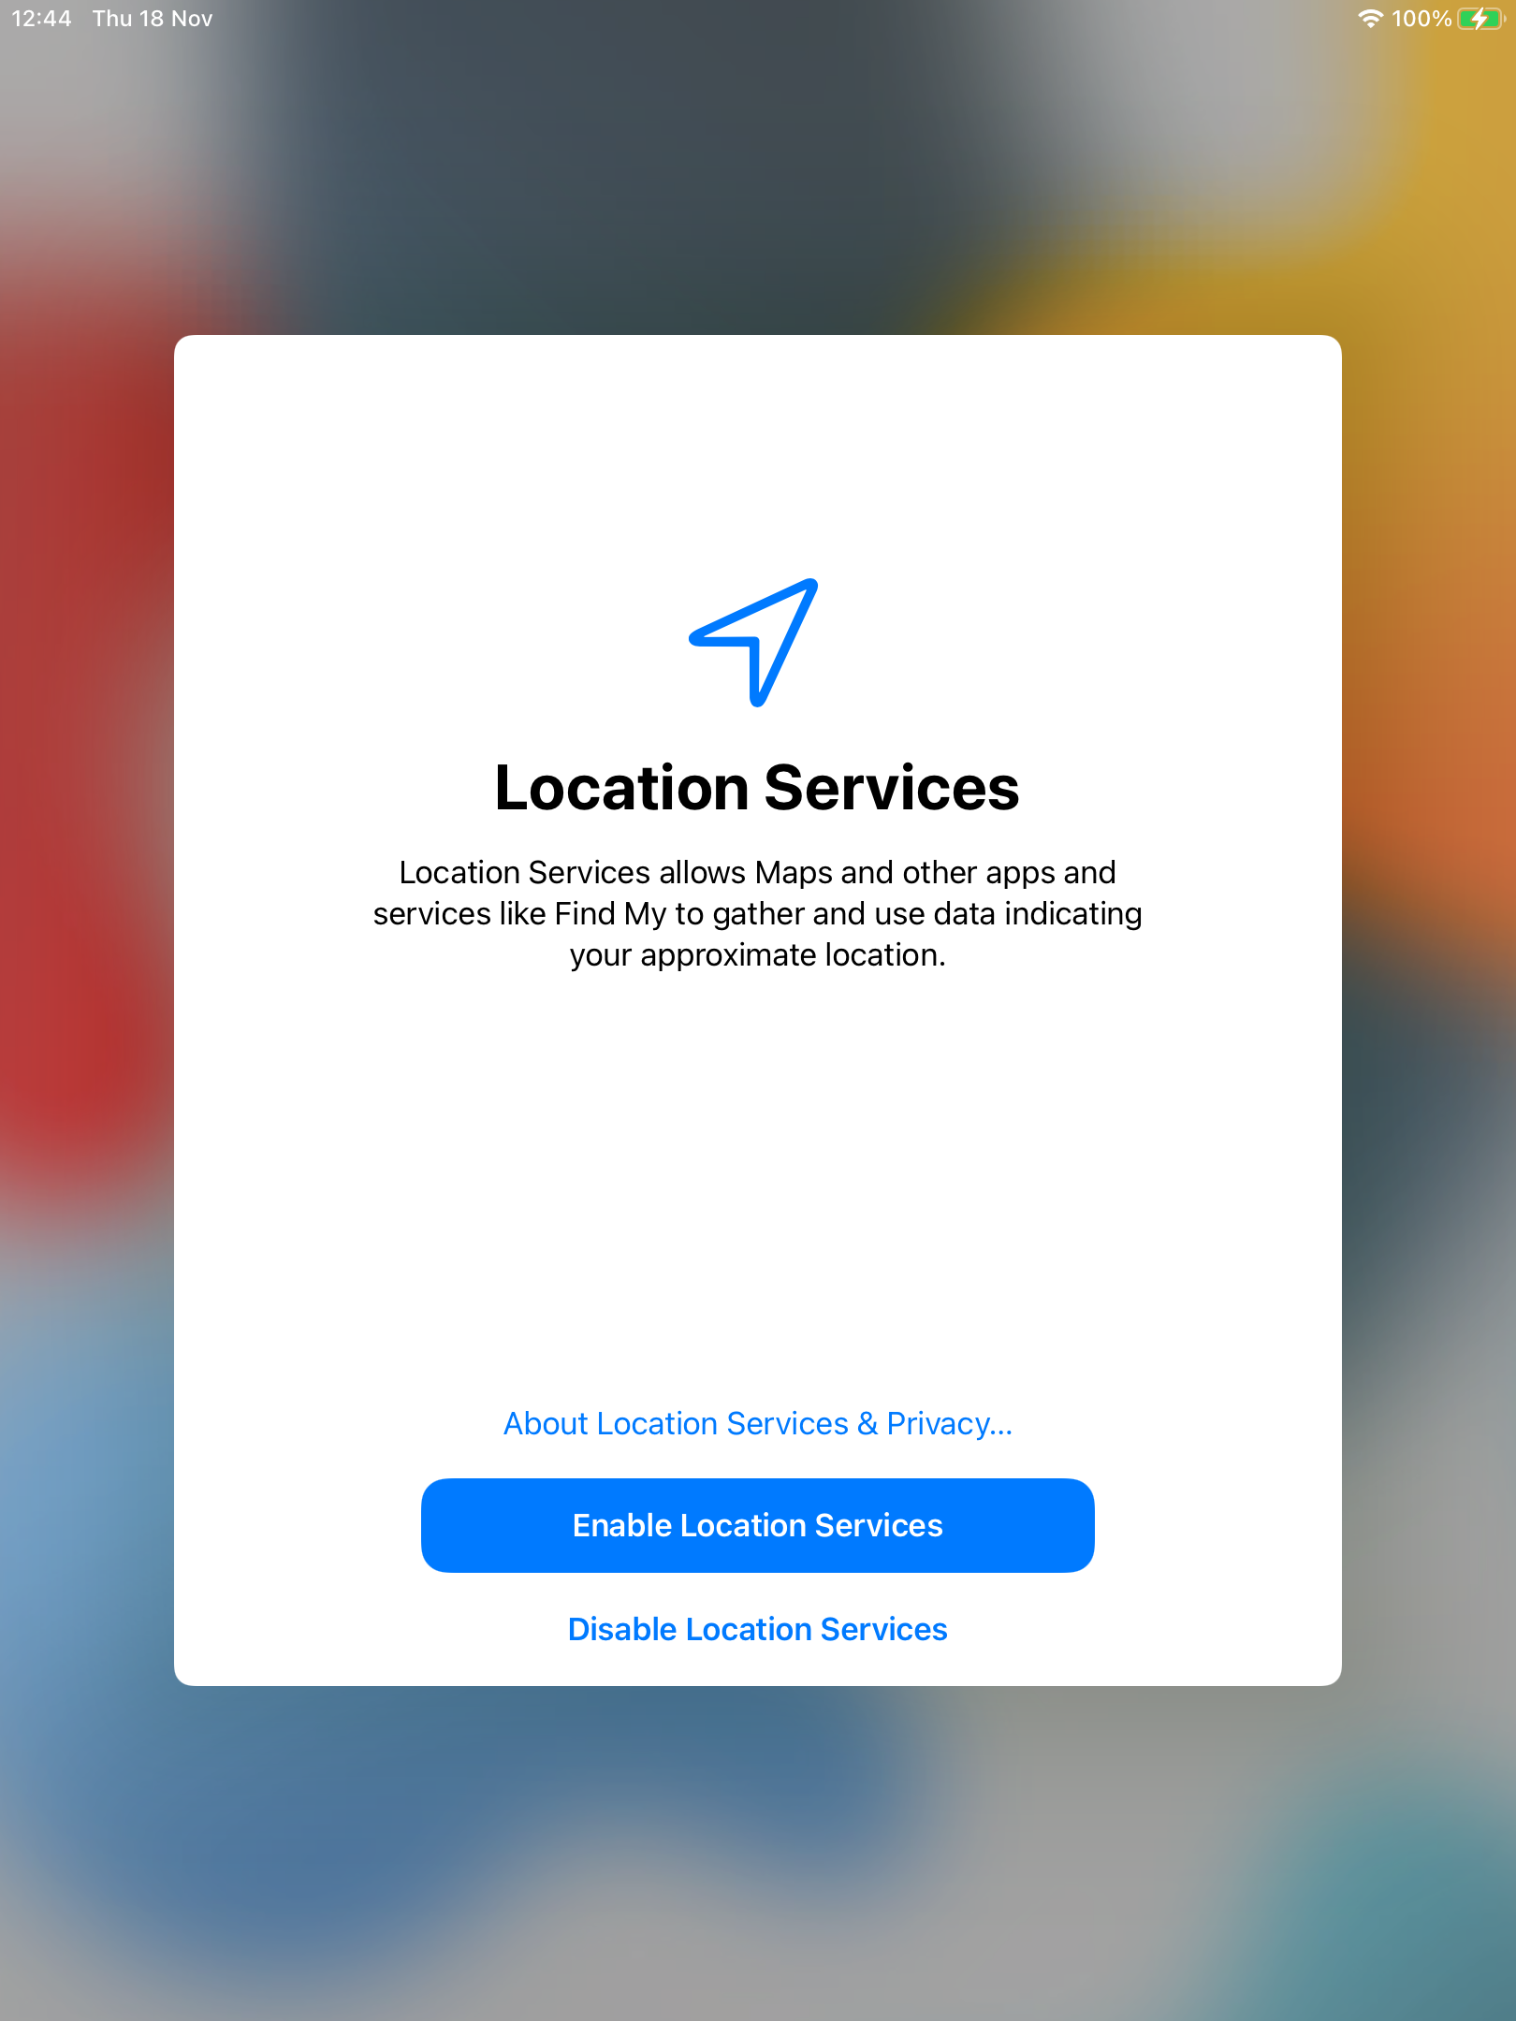
17. Location Services
Tap Enable Location Services button

Slide 24
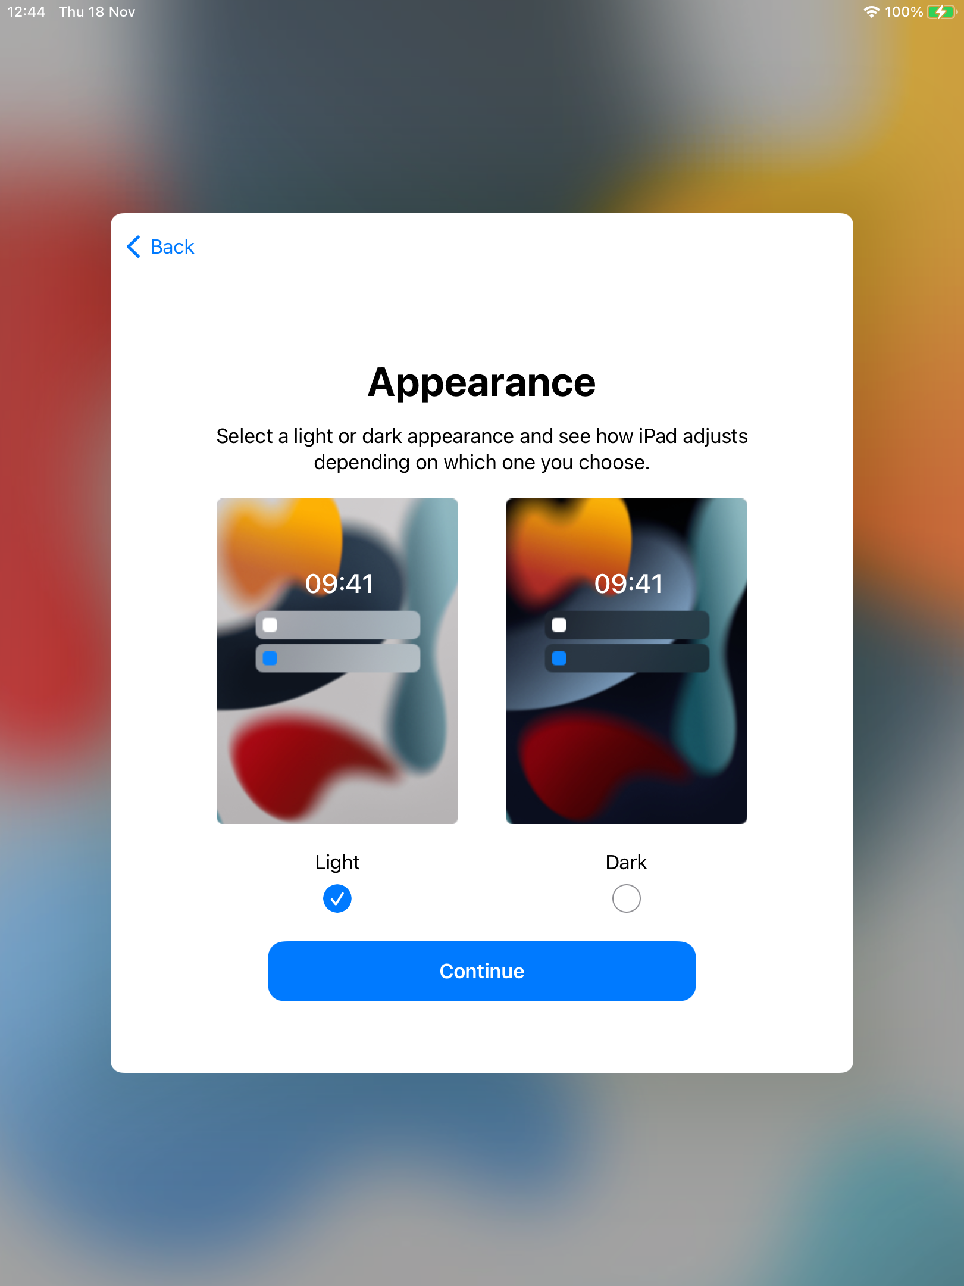
18. Appearance
Confirm your background appearance setting.
*Select either Light or Dark, whichever you prefer.
Tap Continue

Slide 25
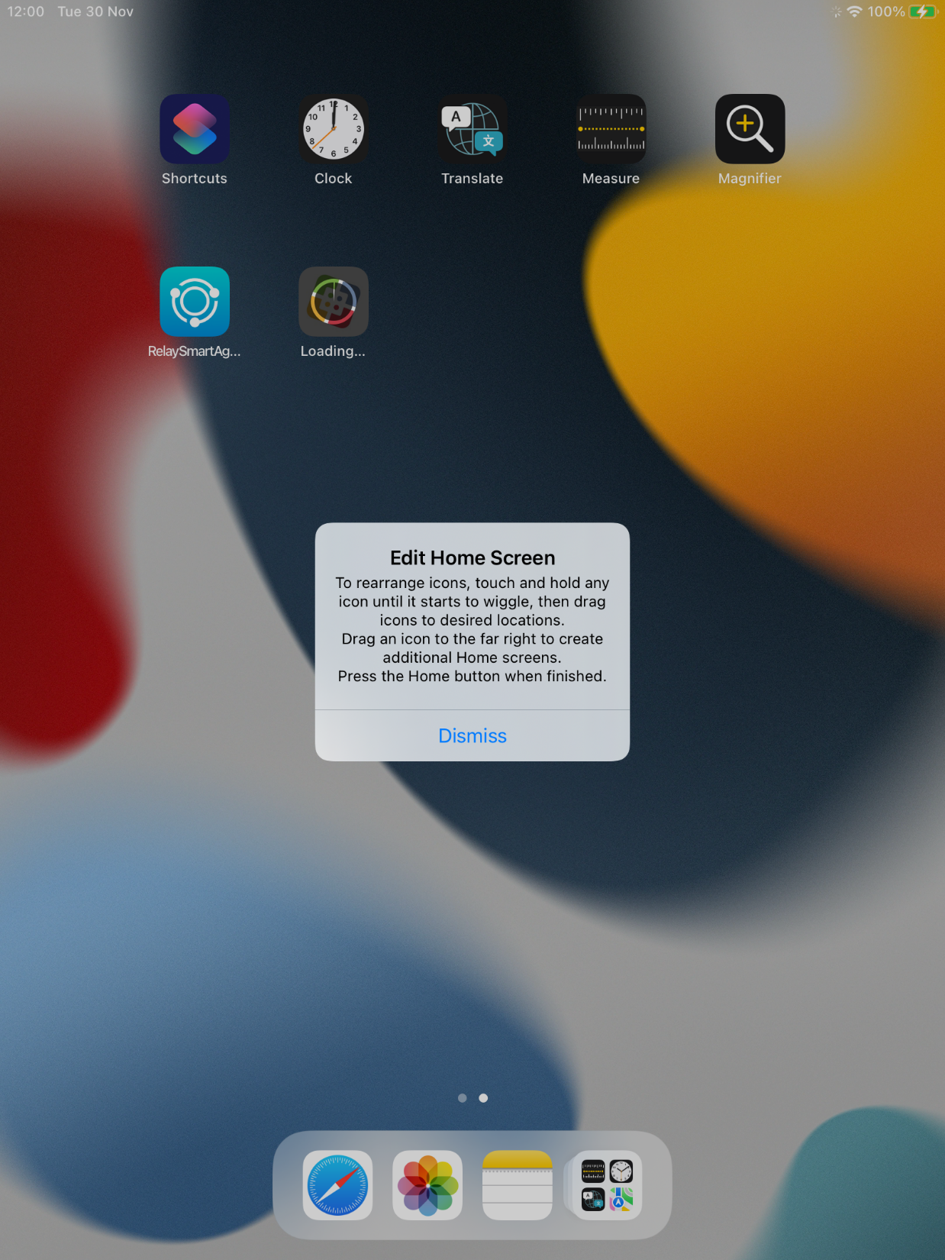
19. Check for “Lightspeed” app loading
After a couple of minutes, the Lightspeed (Relay Smart Agent) app completes Installation
Then the Self Service app will Install
The ‘Edit Home Screen’ popup may not appear, if it does tap Dismiss

Slide 26
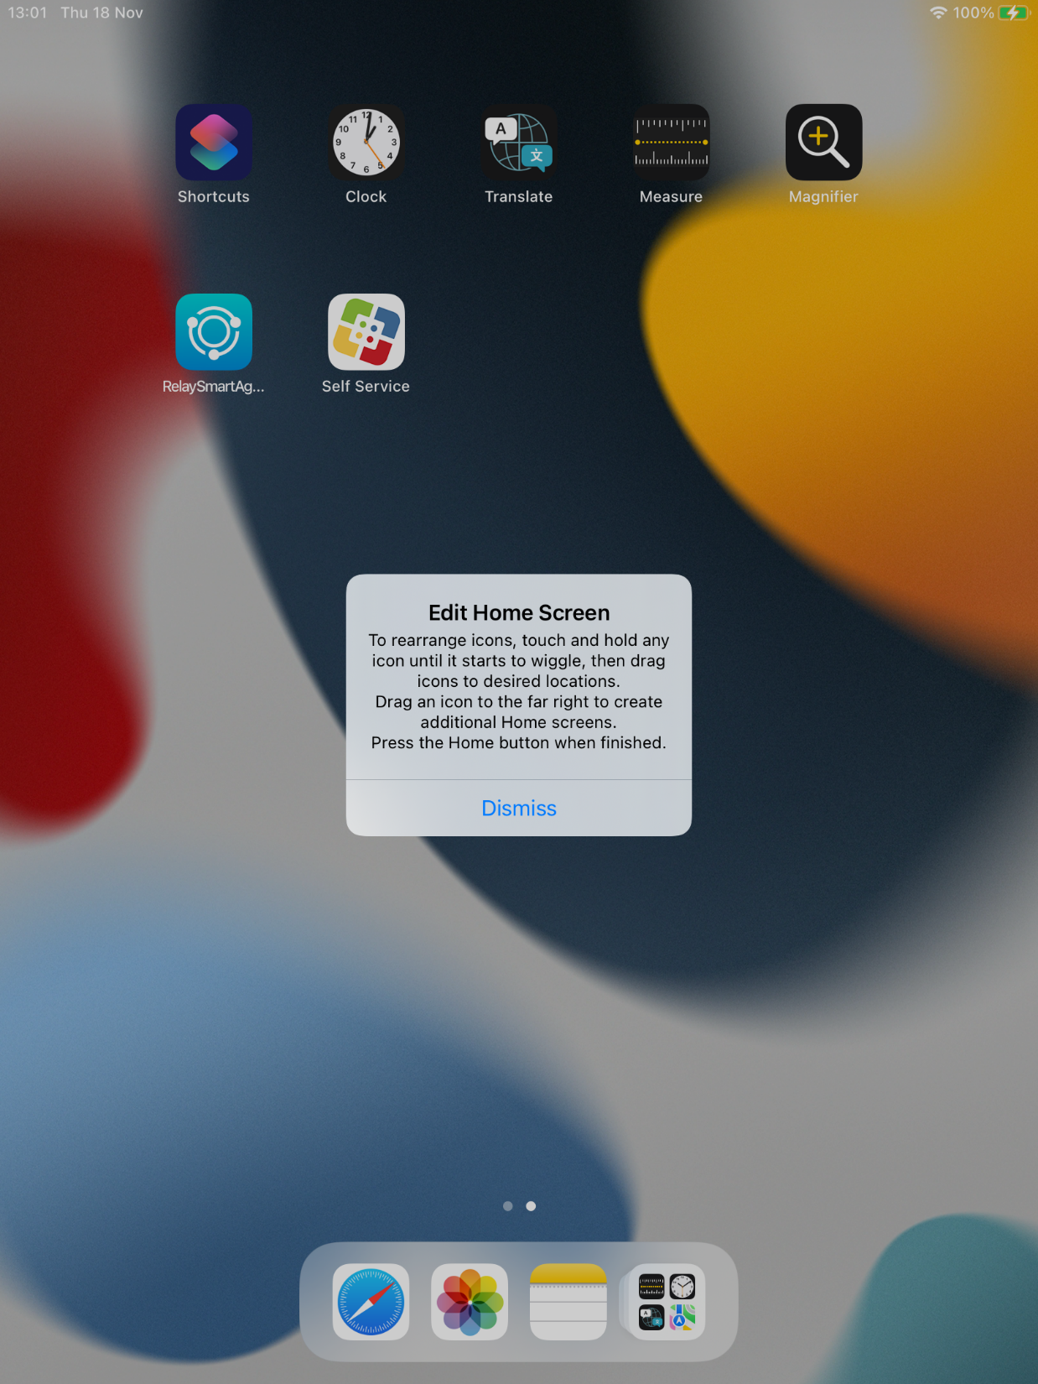
20. Check for “Self Serve” app loading
Self Serve app has now downloaded.
This is where you will get all the apps you can use at school and at home.
Tap Dismiss the Edit Home Screen popup.

Slide 27
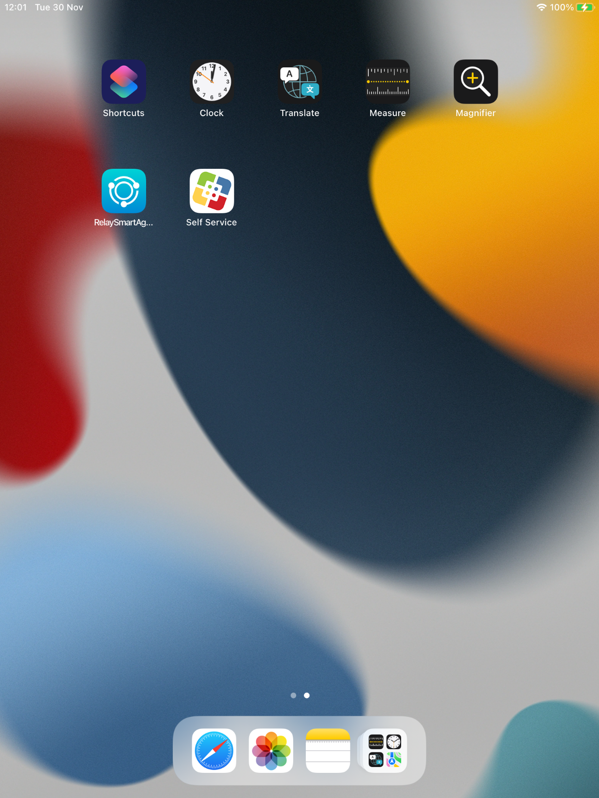
21. Home Page
You have now completed your iPad set up.
Thank you!

