Slide 1
Making sure you get notifications from your class teachers on TEAMS
Your teachers will send you a request to join meetings, live lessons, assignments due and work posted on the TEAMS site. If you are not receiving these alerts or want to check you are receiving them for all subjects – follow the instructions below.

Slide 2
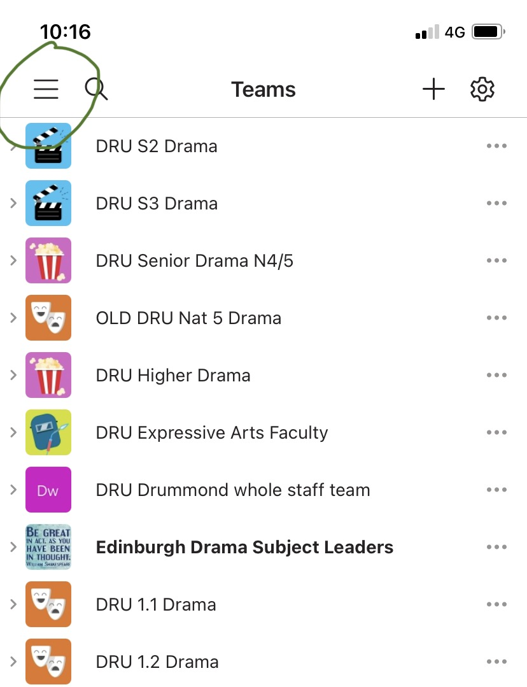
Go to the three lines top left when you open teams (next to the search bar)

Slide 3
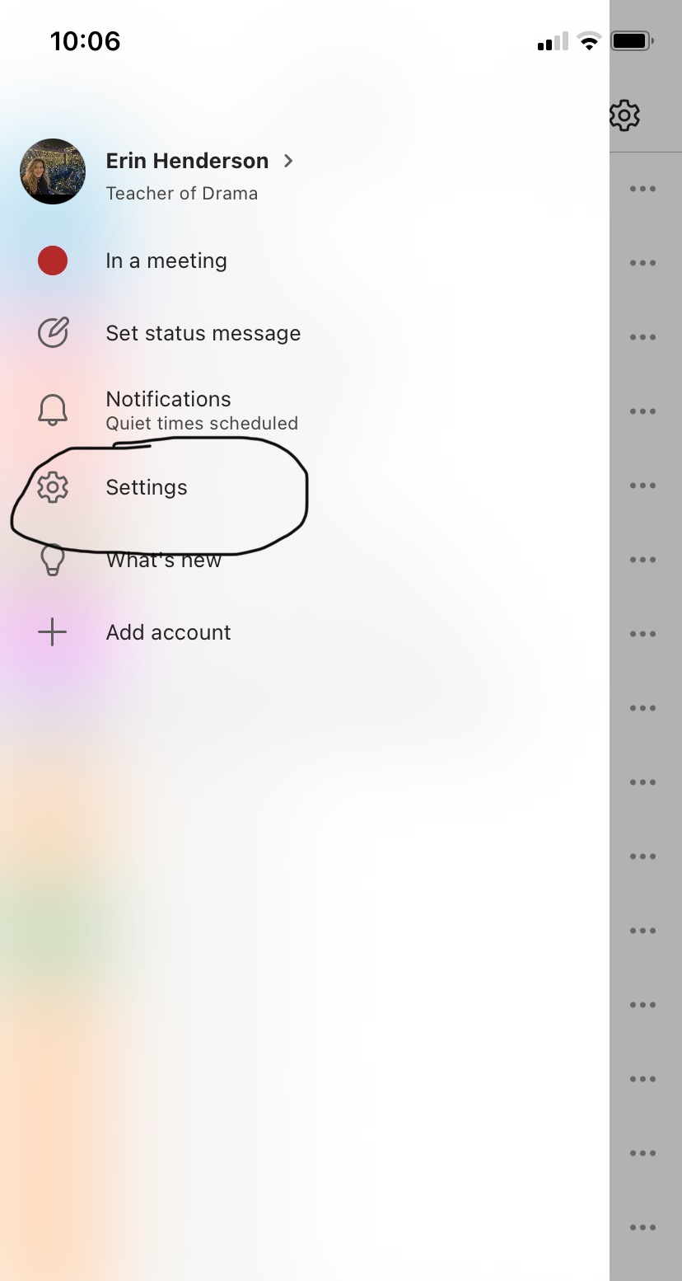
Go to settings

Slide 4
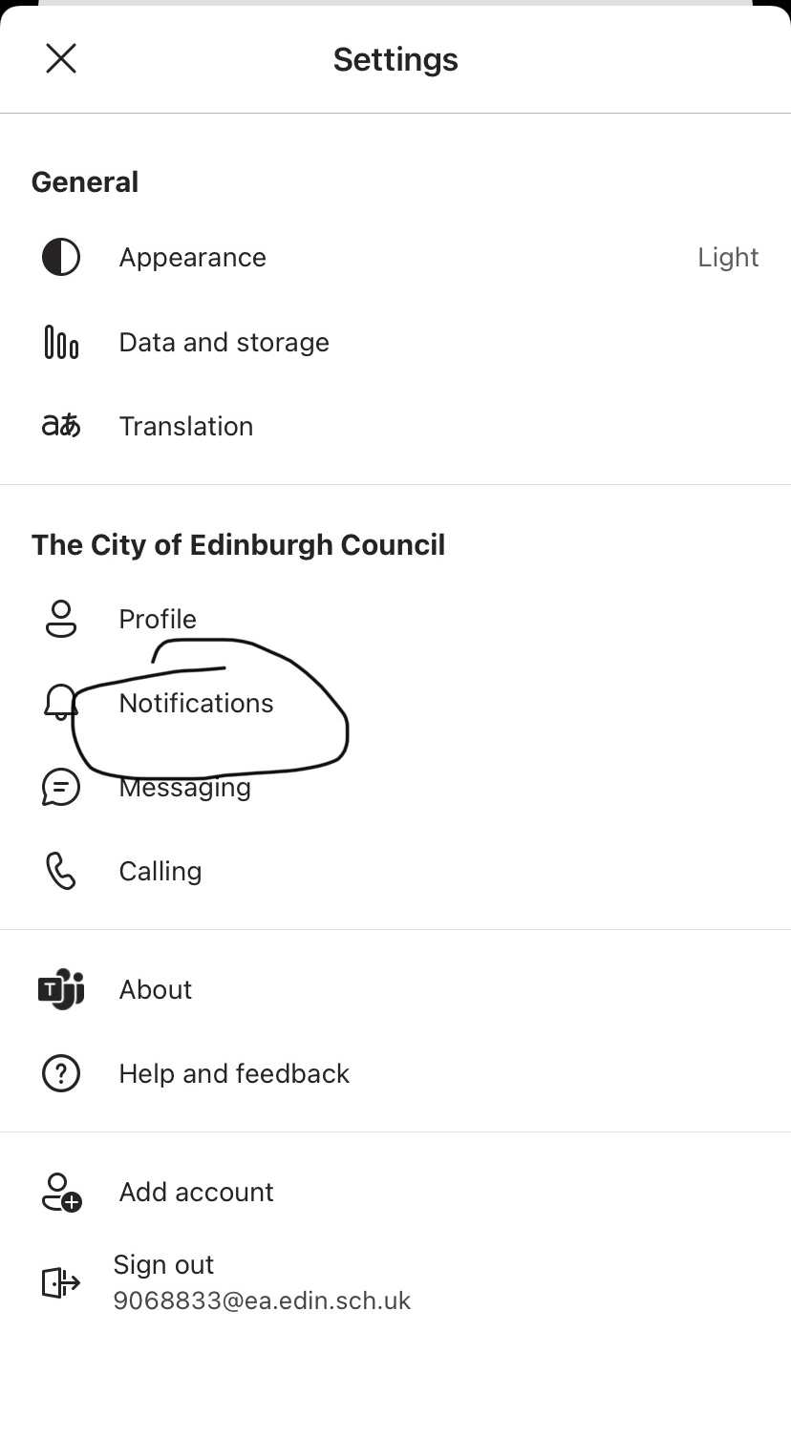
Go to notifications

Slide 5
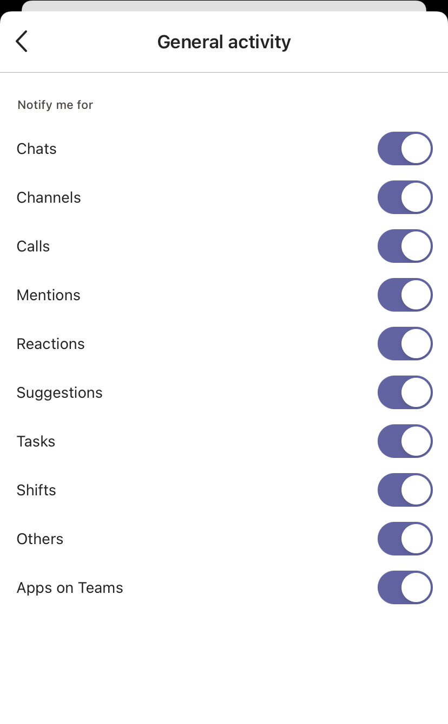
Go to general activity and make sure all options are selected

